Slide 1
Pembrey at war – Lesson 5

Slide 2
Aims
Market Pembrey County Park as a heritage attraction

Slide 3
What do I know about Pembrey Country Park?

Slide 4
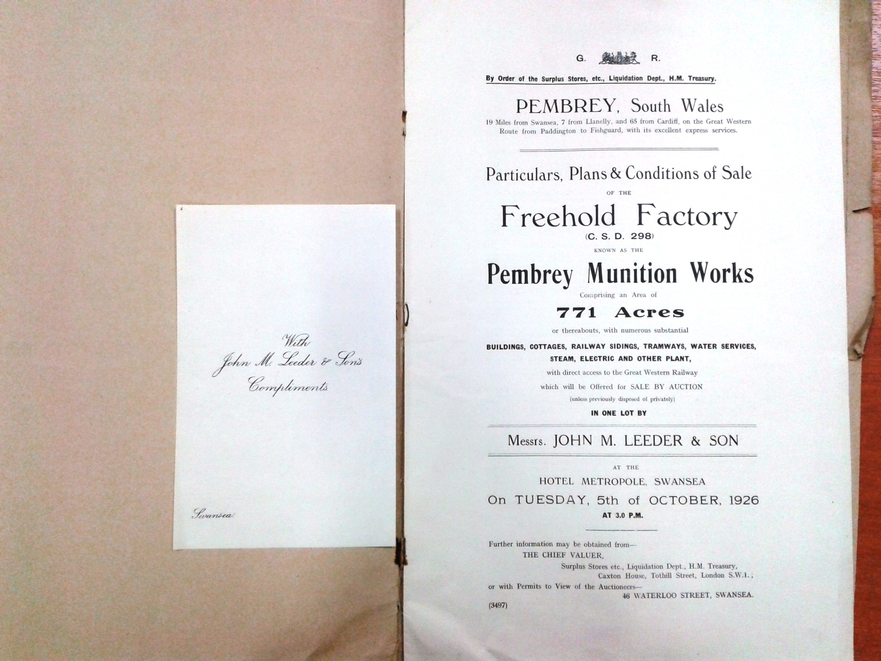

Slide 5
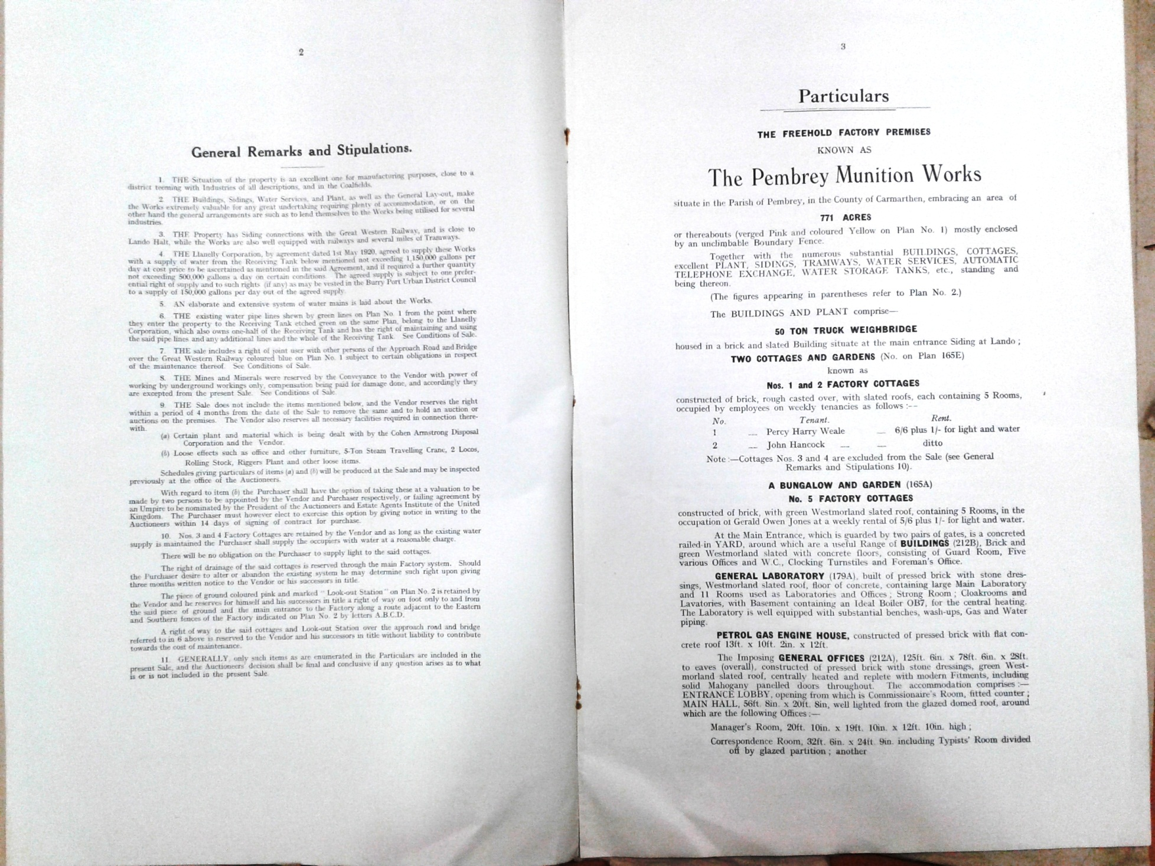

Slide 6
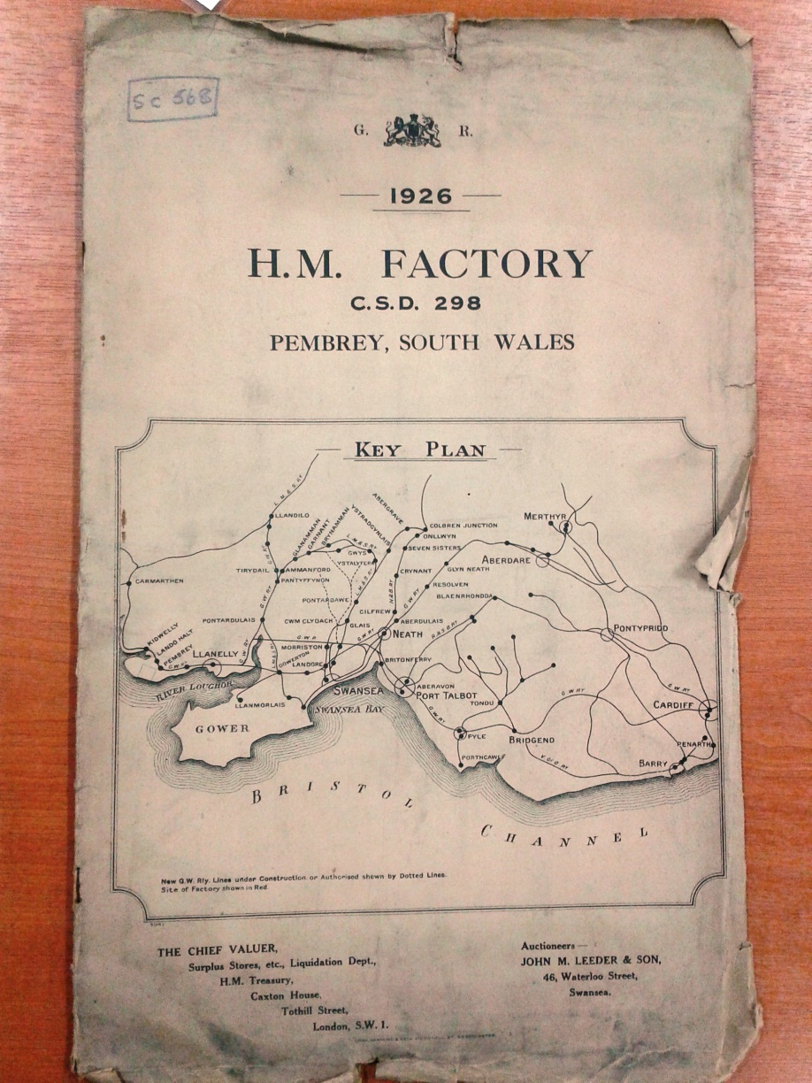
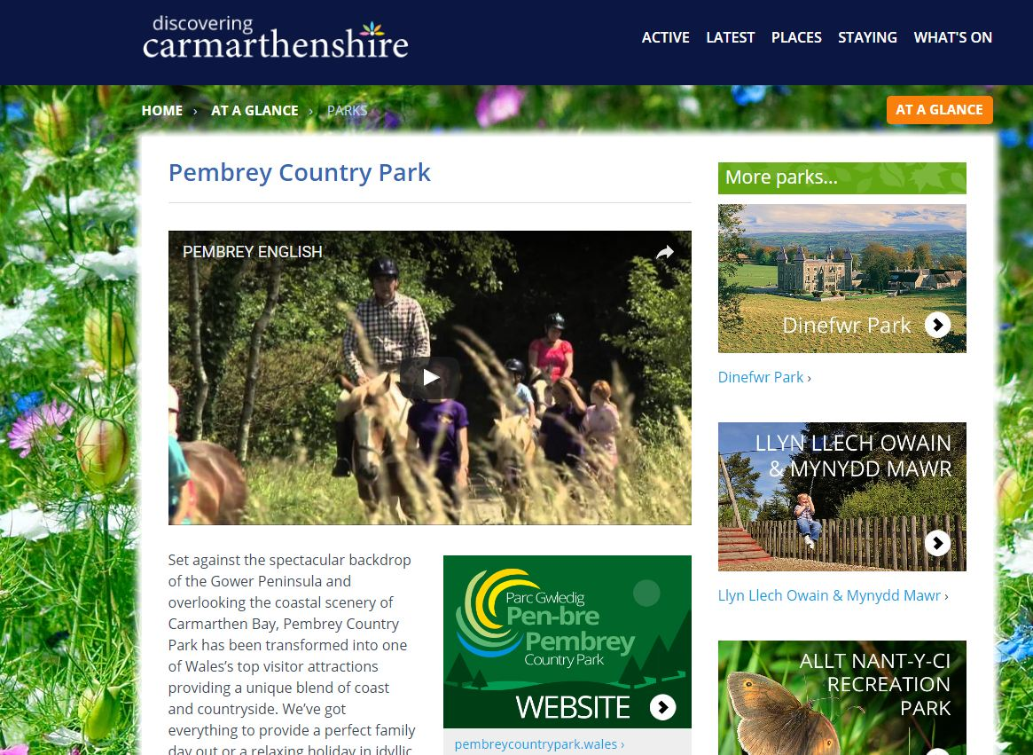
The site was eventually closed in 1964 and opened as a Country Park in 1980.
Question 1; Looking at the images of the sale catalogue why do you think it sold for scrap?
Question 2; Thinking about the park today how is it marketed?

Slide 7
Now it’s your turn. Imagine you are responsible for marketing Pembrey Country Park as a heritage attraction.
Look at how other heritage sites are marketed.
Think about leaflets left at motorway services which advertise tourist attractions to see how they are marketed.
Things to consider
The target audience
The costs associated with marketing
How will you market this attraction (i.e. leaflets, tours, advertising in paper, website, posters, social media)
What aspects will you market
How do you make these exciting and attractive
Does anything need to be added to make your proposal more successful

