Slide 1
Conscientious Objectors
History – Lesson 3

Slide 2
Aims
To investigate what life was like for the conscientious objectors who were sent to work at Llyn y Fan Fach
To discover what happened to conscientious objectors after the war ended.

Slide 3
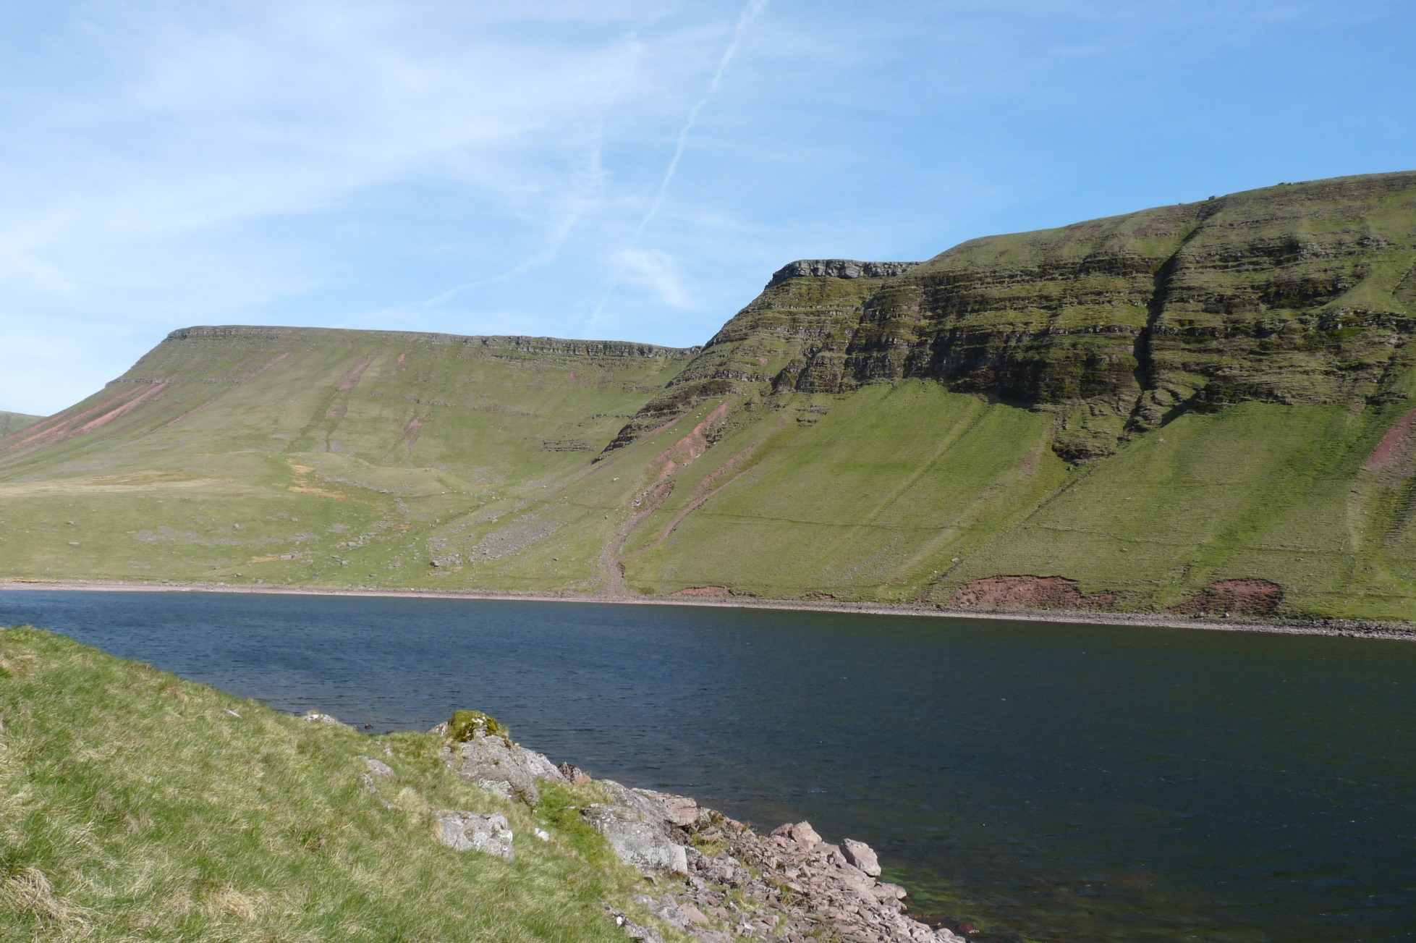
Llyn y Fan Fach

Slide 4
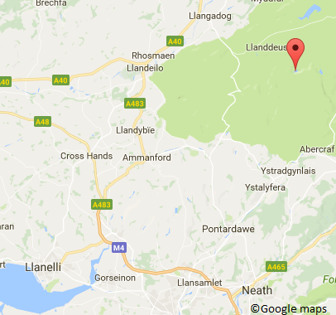
A water supply for rural Llanelli.
During the early part of the 20th century rural Llanelli was faced with a huge problem—Water! There was no piped water reaching the area and local wells were not providing enough water to the people. Population had risen 34% from 1901-1911 so demand was increasing rapidly.
The local council started looking for solutions. The vicar of Pembrey suggested a lake close to Llanddeusant where he had previously officiated.
Llyn y Fan Fach was a glacial lake over 10 miles away from Llanelli. Surveyors were sent to investigate whether it would be a viable option.
‘Llyn-y-Fan seems to stand alone in the field.’
‘ No other source will meet the requirements of the case.’

Slide 5
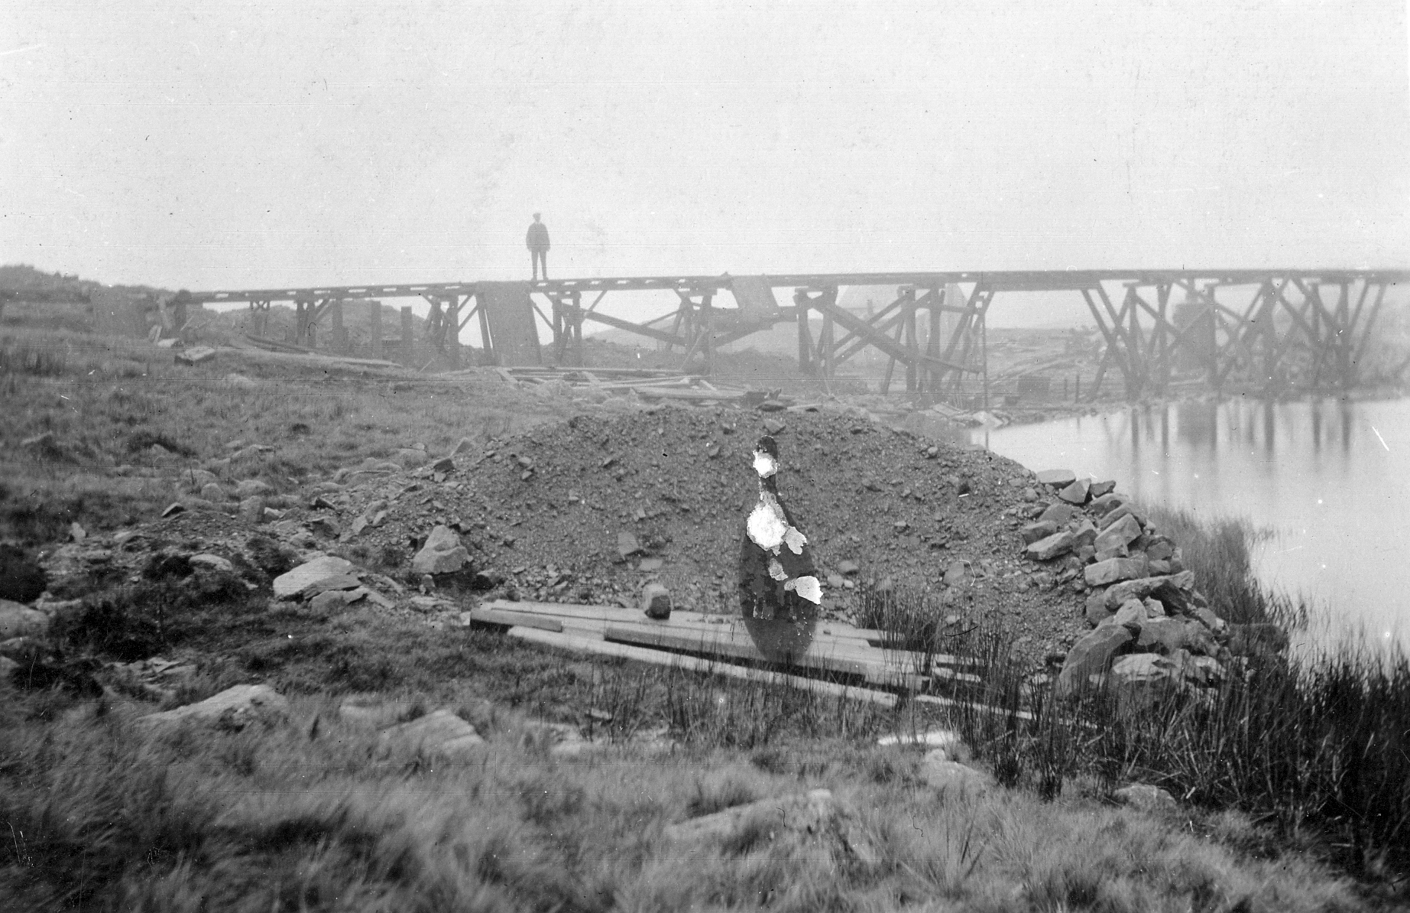
It was decided that Llyn y Fan Fach would be the ideal source of water for rural Llanelli so the project was approved in 1912 and began in 1914 after contractors were found to undertake such a huge task.
175 Irish navvies (a term used to describe manual labourers working on major civil engineering projects) were brought in to provide the bulk of the workforce. However conditions were harsh. Getting to the site was rough and steep and at an altitude of 1,200ft the weather on site made working conditions difficult. The Irish navvies refused to work there and left.

Slide 6
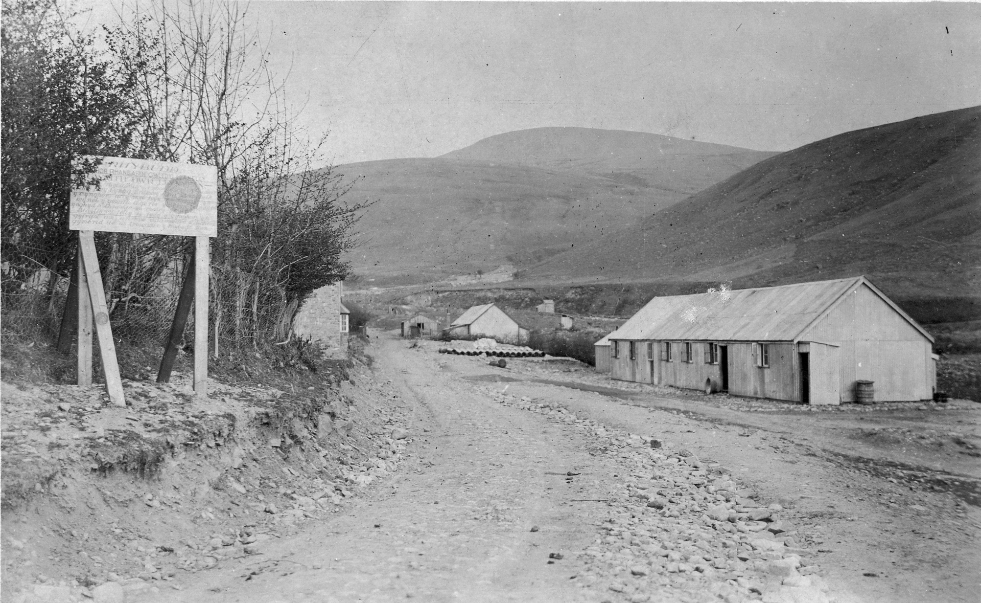
In 1916 around 150-200 conscientious objectors were transferred from various prisons in England to complete the works. They lived on site in two huts, there was also a cooking hut, laundry hut, a shop and a small hospital hut.

Slide 7
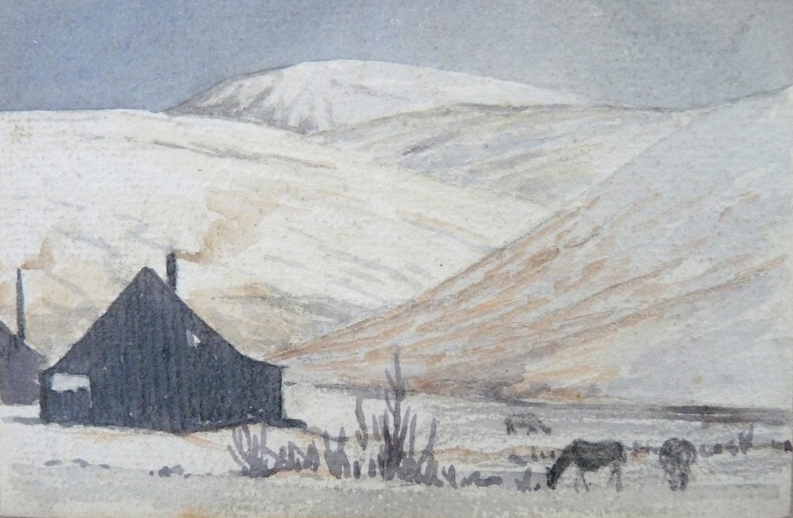
Why were conscientious objectors transferred to work at Llyn y Fan Fach?
What does this painting from the Mary Walmsley collection tell you about conditions working and living at Llyn y Fan Fach?
Sketch taken from the autograph book of Peter Davies, from the collection of Mary Walmsley.

Slide 8
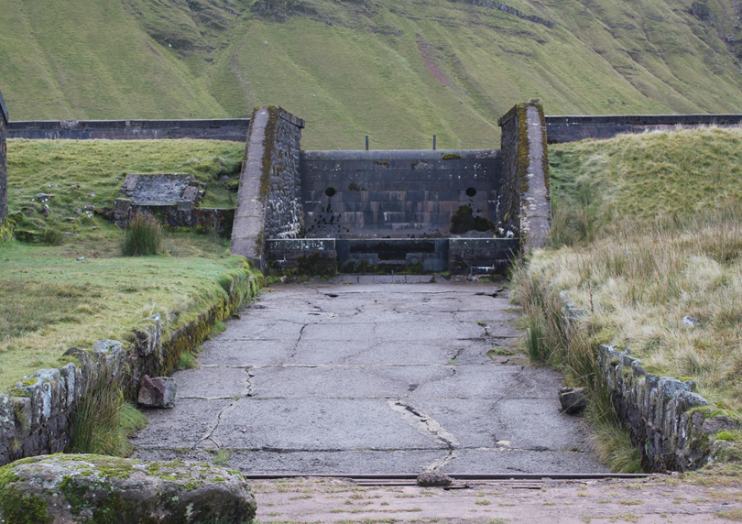

Slide 9
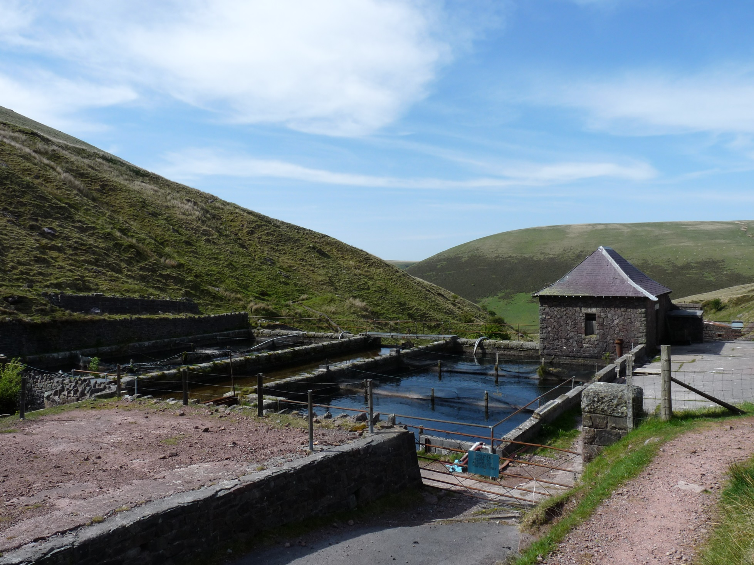

Slide 10
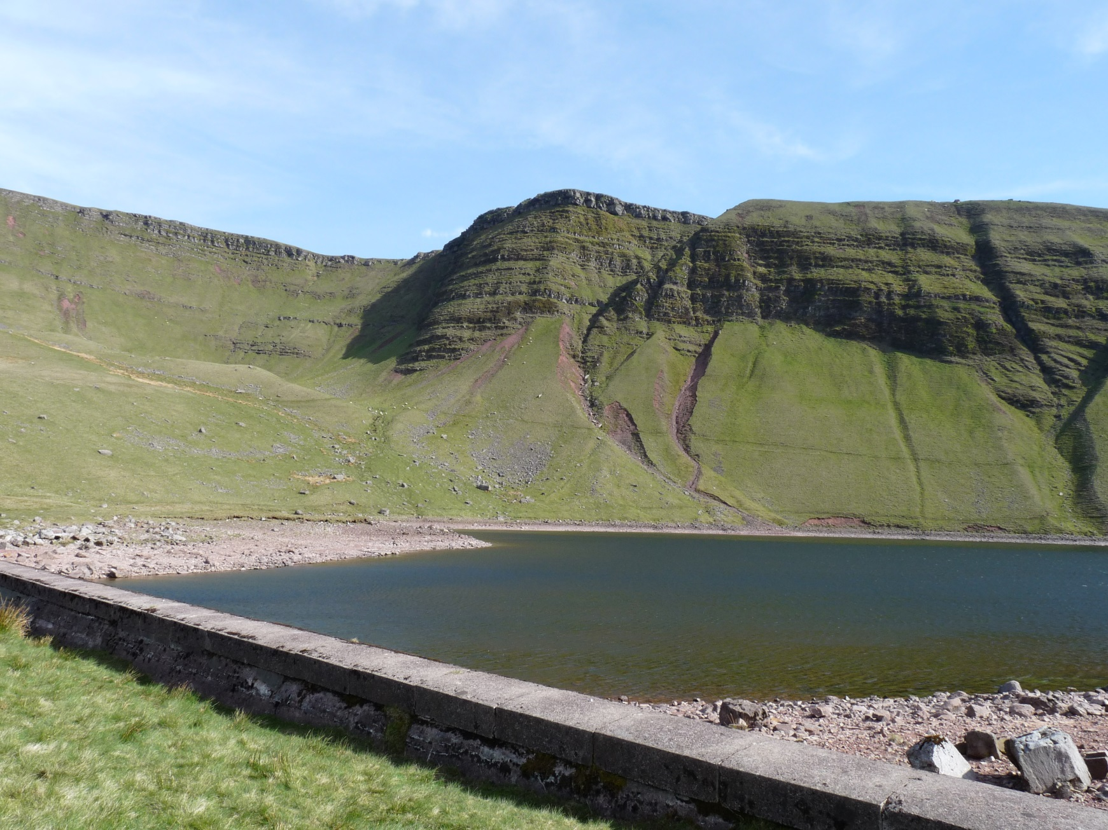

Slide 11
I get up at 5am to start work at 6am. I have my breakfast and get ready for work.
We start the day by loading the train trucks with stone to go up to the lake.
Bedtime at 11pm
We finish work at 8pm as it is starting to get dark. We have a quick meal and it’s nearly time for bed
We have a short break at 10am, it’s started to rain and we have no shelter.
A conscientious objectors day
After a break at 4pm we start working again, moving stones and earth. The wind has started to pick up and it’s very cold.
1pm is lunch time, the food isn't very good and I always wish there was more.
After lunch we continue loading bricks and mixing cement.

Slide 12
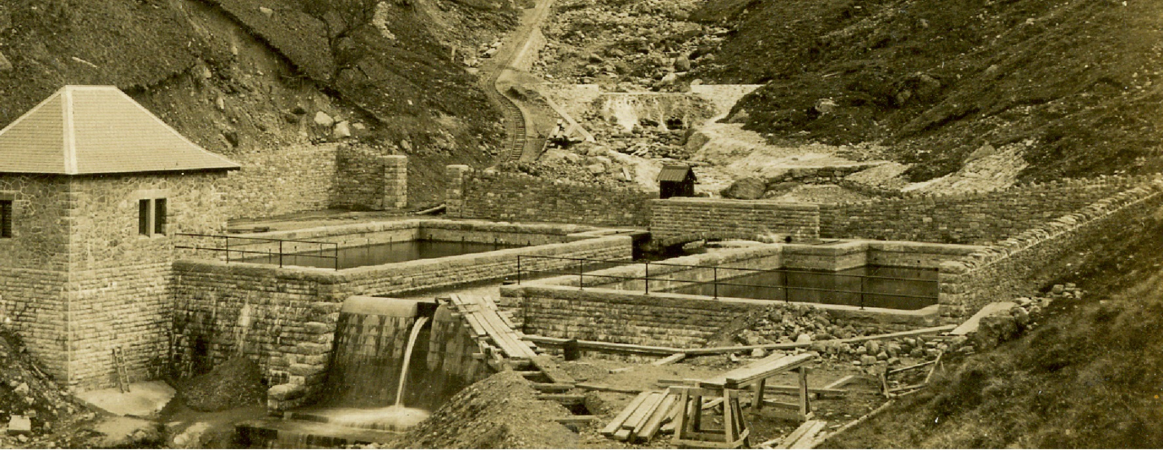
Compared to your day, do you think the daily life of a conscientious objector was hard? Explain your answer
Was going to war and fighting a better option?

Slide 13
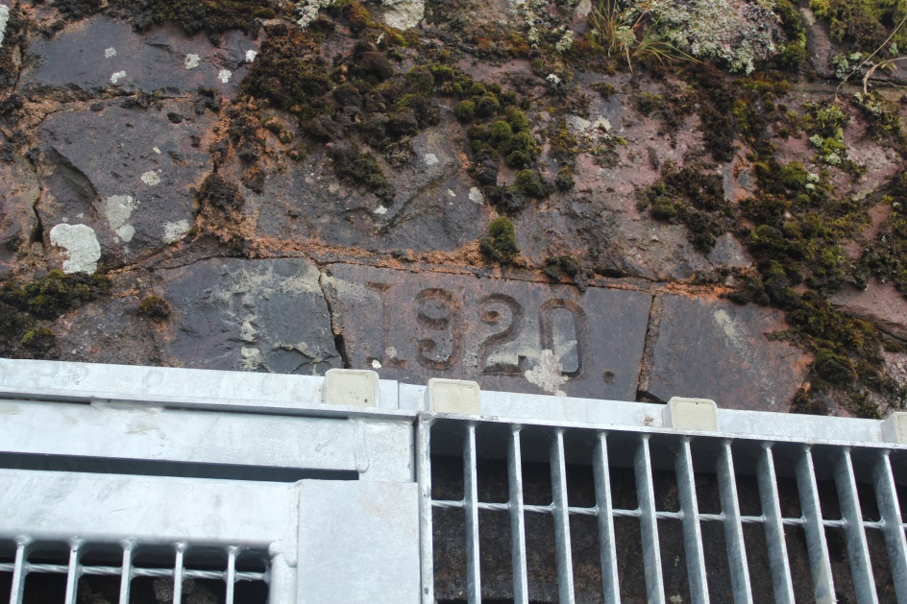
On 11th November 1918 the First World War ended.
Many conscientious objectors believed they would be released straight away; however this was not the case. In April 1919 the first of the objectors were released.
Why did it take so long to release the conscientious objectors?
Do you think life returned to normal for them afterwards? Explain your answer
Dated brick above the main water pipe at Llyn y Fan Fach.

Slide 14
What were attitudes to conscientious objectors like after the war?

