Slide 1
Conscientious Objectors
History – Lesson 2

Slide 2
Aims
To argue your case – was conscientious objection right or wrong?
To find out what difficulties conscientious objectors face during WW1.

Slide 3
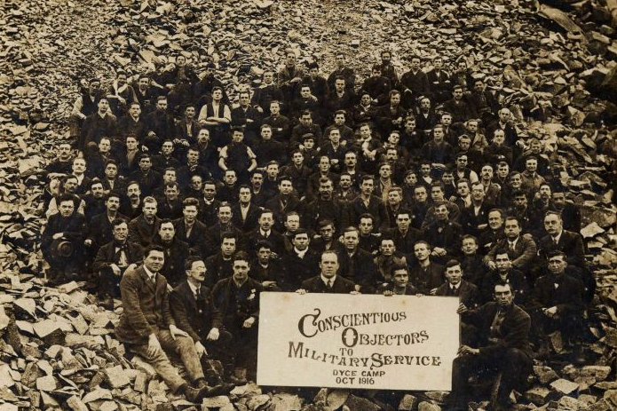

Slide 4
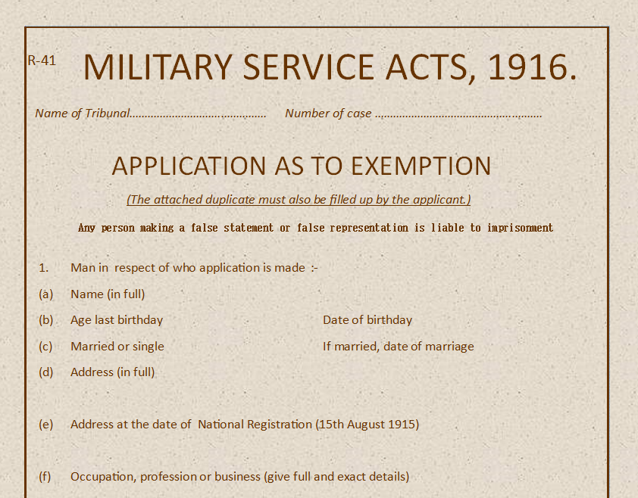
Last lesson you completed your application as to exemption.
Now it’s time to argue your case.

Slide 5
Now it’s time to argue your case for your objection.

Slide 6
Decisions of the tribunal
Absolute exemption from military service
Exemption from military service provided he did civilian work of national importance.
Non-combatant (fighting) service and send objector to non-combatant unit in the army
Rejection of the application completely ordering the objector to join the military immediately.

Slide 7
Decisions of the tribunal
Do you think the decision of your tribunal was fair?

Slide 8
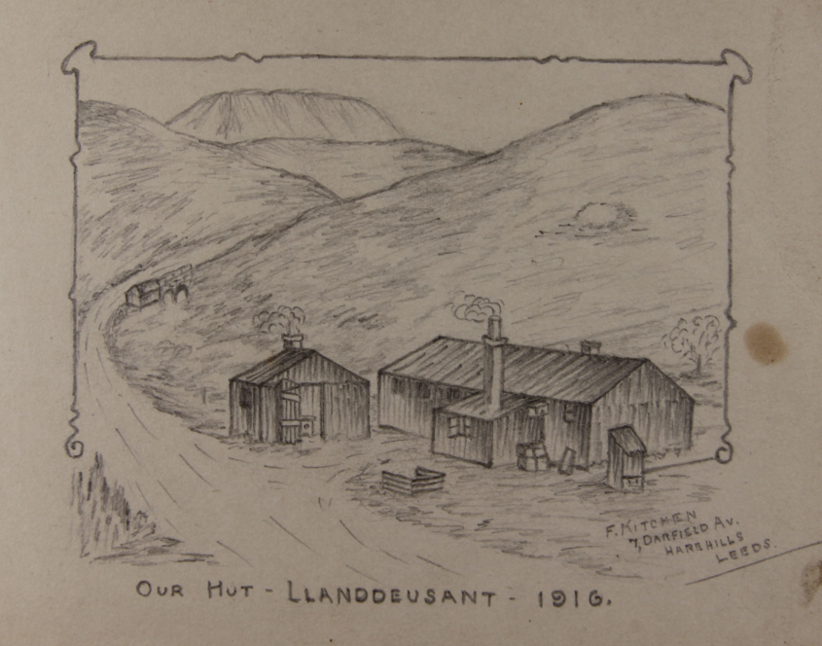
If an objector’s tribunal was refused then they could appeal the decision.
If their appeal was refused then they would receive a call-up notice telling them to report to their regiments. Many decided to ignore the notices. They were then arrested and escorted to the army. If they continued to refuse and disobey orders they would be court-martialled and finally they were sent to prison.
Sketch taken from the autograph book of John Taylor

Slide 9
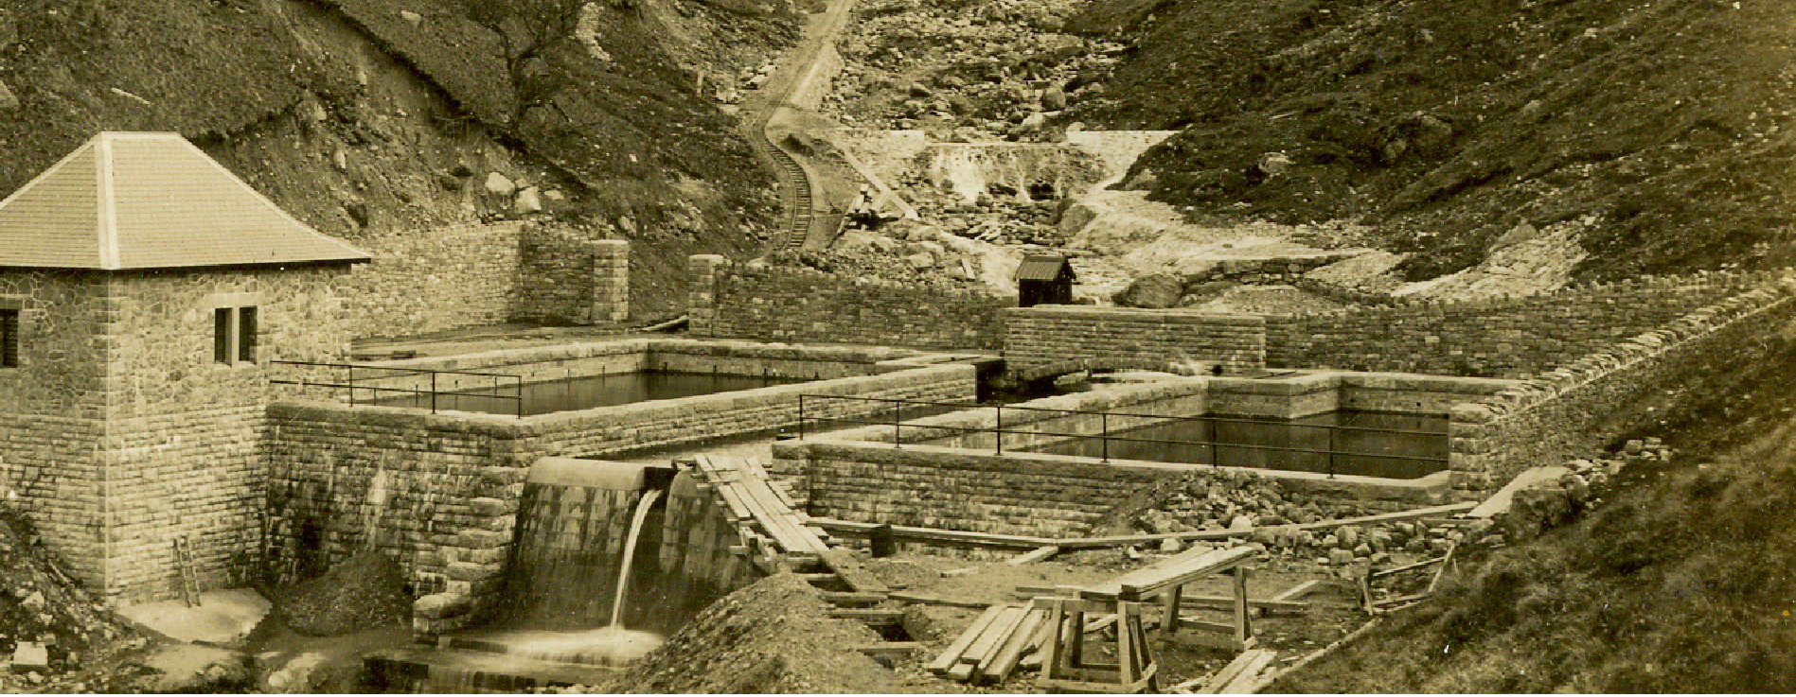
August 1916 saw the introduction of Home Office Scheme – work camps set up by the Government. One of those schemes was the water works at Llyn y Fan Fach on the western side of the Brecon Beacons. Conscientious objectors were sent to work at the camp.

Slide 10
