Slide 1
Conscientious Objectors
History – Lesson 1

Slide 2
Aims
To discover who the conscientious objectors were.
To investigate why they didn’t want to go to war.

Slide 3
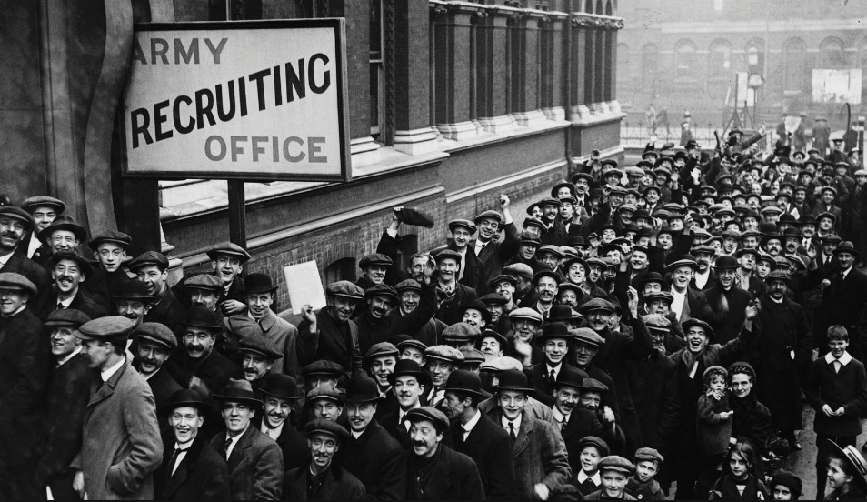
When the First World War began in July 1914 everyone believed it would be over by Christmas. Millions of men left home to fight believing it was their duty. Some were as young as 14, lying about their age in order to fight for their country.

Slide 4
'The state should have the right to compel the individual to fight for their country, and to give up their life if necessary, in time of war.'
In your groups discuss whether or not you agree with this statement.

Slide 5
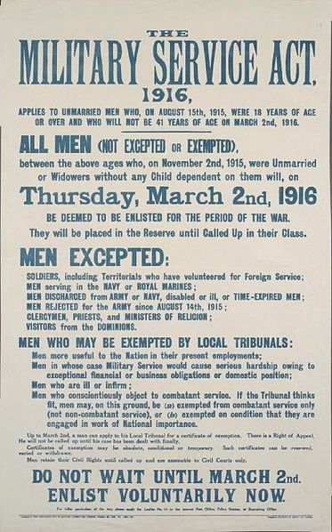
However when the war continued, more men were needed to fight and volunteer numbers started to drop. In 1916 conscription (being ordered to join military service) was introduced for all men aged 18-41. A conscience clause was added for those who had a ‘conscientious objection to the undertaking of combatant service’ Those whose beliefs meant they could not fight were sent to face a tribunal to argue their case. Men objected for a variety of different reasons.

Slide 6
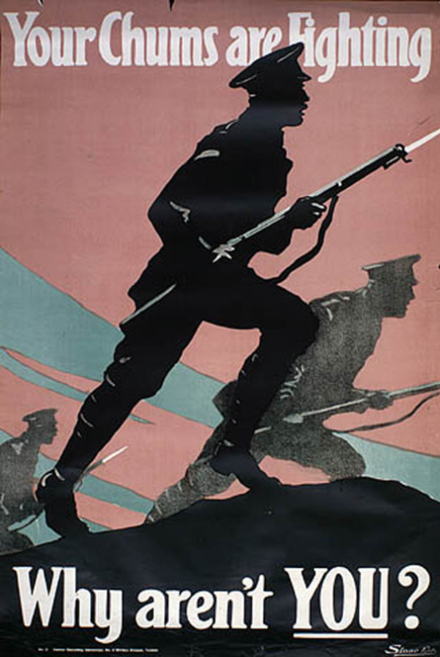
Questions
What was conscription and why was it introduced?
What is a conscientious objector?
3. What reasons do you think someone had for not going to fight during the war?

Slide 7
Religious objectors.
Men who objected to war as it was against the beliefs in their religion. This was the largest group of objectors and mainly included Quakers and Jehovah Witnesses.
‘Thou shalt not kill’.
Pacifists and political objectors
The pacifist conscientious objectors believed that all war was wrong. They believed that all violence was wrong and that negotiation was the preferable way of settling disputes.
Political objectors were those who did not consider Germany to be the enemy.
Conscientious objection.
4. Which do you believe is the most valid reason? Support your answer with reasons.
Absolutists and Alternativists
Absolutists were opposed to the conscription law and also to war. They believed that their civil liberty and the freedom of the individual should be upheld.
Alternativists did not agree with the war however they were prepared to undertake civilian work.
Non—combatants
Non-combatants were prepared to be conscripted but not to bear arms or to kill. They were usually given other tasks like stretcher bearers or medics.

Slide 8
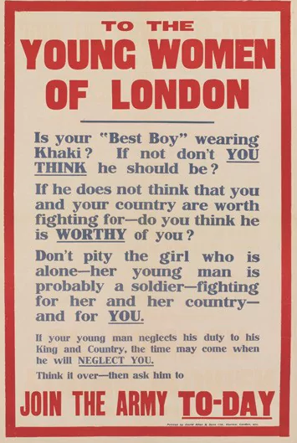
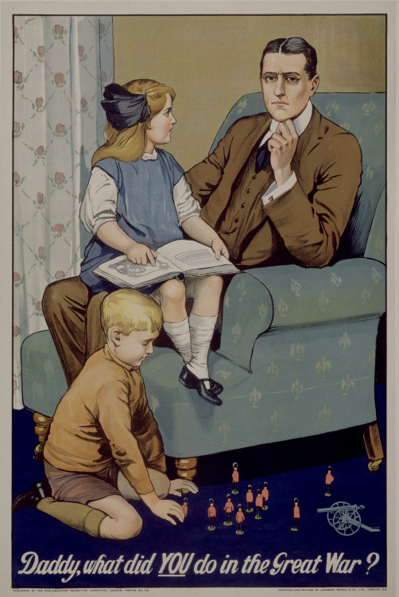
What are these posters designed to do?

Slide 9
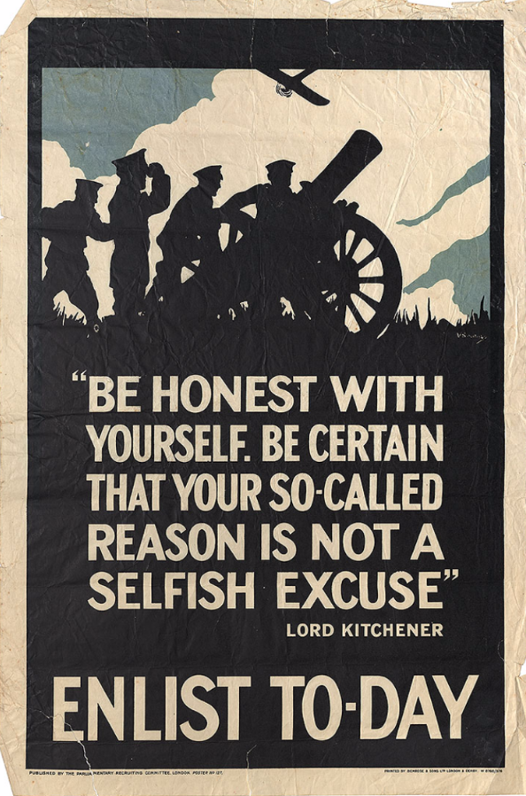

Slide 10
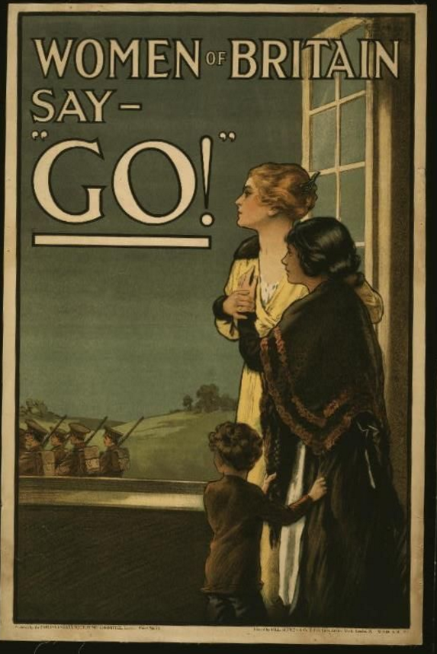

Slide 11
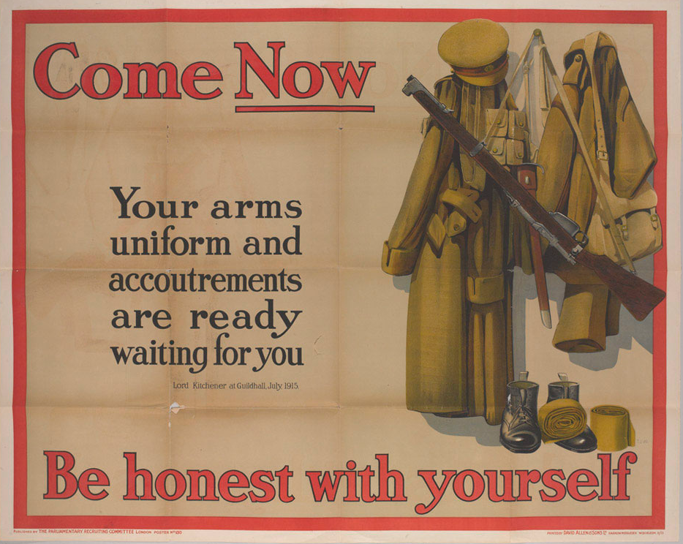

Slide 12
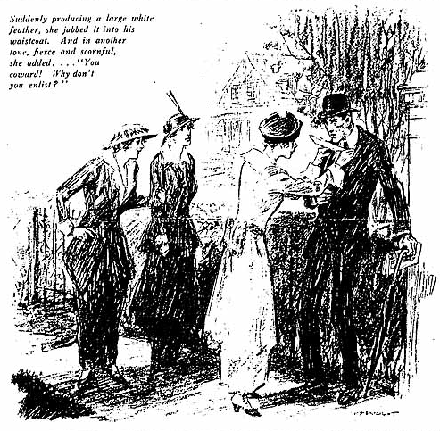
What does this source tell us?
Is this source biased?
"The White Feather: A Sketch of English Recruiting", Collier’s Weekly (1914)

Slide 13
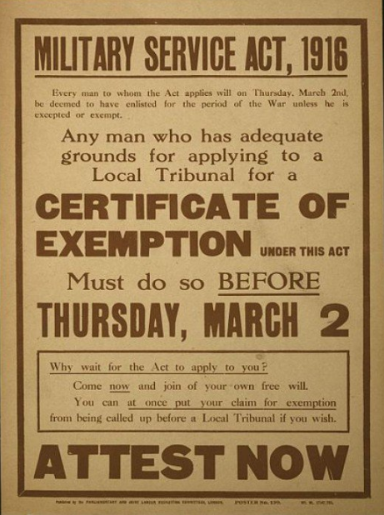

Slide 14
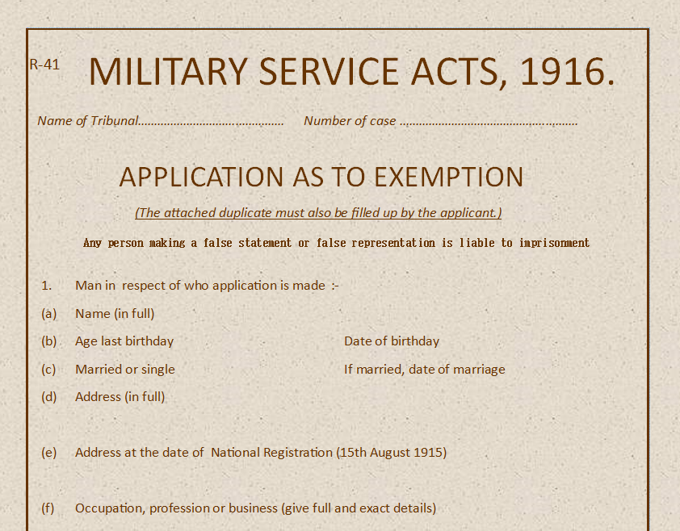
Application as to exemption.
Imagine you are now a working adult, complete the form as a conscientious objector.
Explain your reasons in detail for wishing to be considered for exemption from conscription.

Slide 15
Application as to exemption.
(a) On the ground that it is expedient in the national interests that the man should, instead of being employed in military service, be engaged in other work in which he is habitually engaged. (b) On the ground that it is expedient in the national interests that the man should, instead of being employed in military service, be engaged in other work which he wishes to be engaged. (c) If he is being educated or trained for any work, on the ground that it is expedient in the national interests that, instead of being employed in military service, he should continue to be so educated or trained. (d) On the ground that serious hardship would ensue if the man were called up for Army service, owing to his exceptional financial or business obligations or domestic position. (e) On the ground of ill-health or infirmity. (f) On the ground of a conscientious objection to the undertaking of combatant service. (g) On the ground that the principal and usual occupation of the man is one of those included in the list of occupations certified by Government Departments for exemption.

Slide 16
Complete the form at home if you have not finished. Next lesson you will be facing a tribunal – Make sure you are ready to argue your case!

