Slide 1
Science
Unit 3

Slide 2
True or false Alkalis are in cleaning products. Our stomach produces too much acid. Universal Indicator turns red in alkalis. Universal Indicator turns red in acids. Universal Indicator turns yellow in weak acids. Universal Indicator turns blue in weak alkalis. Toothpaste is an acid. Lemons, Limes and Oranges are weak alkali. Car batteries contain a very strong acid that can burn metal. Limestone is alkaline.

Slide 3
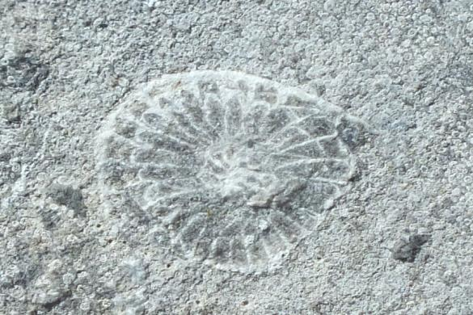
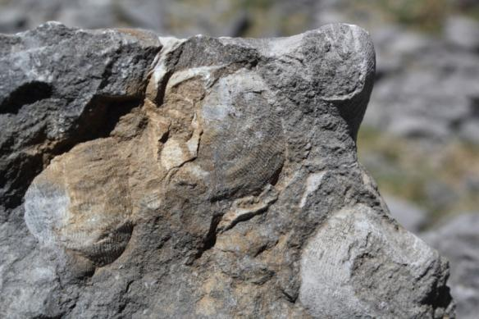
Limestone is made from the remains of millions upon millions of tiny sea creatures that sank to the bottom of a shallow tropical sea when they died just over 300 million years ago, sea when Britain was on the equator! If you look carefully you may discover the fossil remains of some of these creatures in the limestone.

Slide 4
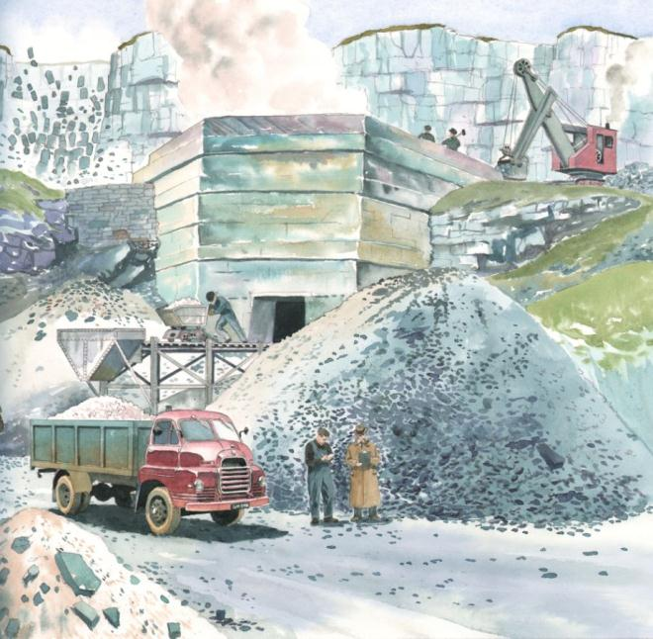
When limestone is affected by heat or acid it transforms into a series of unstable chemical compounds, before eventually turning back into Calcium carbonate. This process is known as the 'Lime Cycle'.

Slide 5
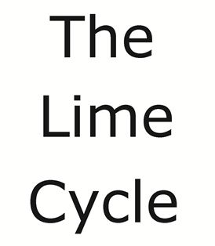
Can you create the lime cycle?
Use the formulas on the next slide. Put them in order to create the ‘lime cycle’

Slide 6
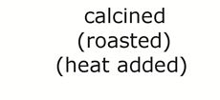
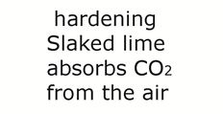
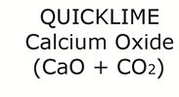

Slide 7
