Slide 1
English
Unit 2

Slide 5
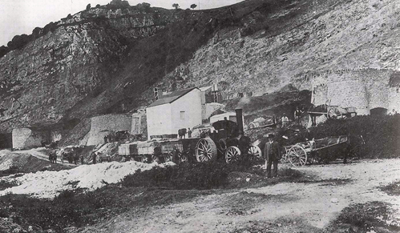
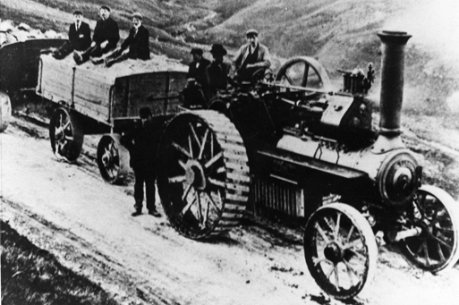
A day in the life of a quarry worker
Imagine you are a quarry worker.
Write about your life in the quarry.
You could write about......
How you came to be a quarry worker
What you have to do as a quarry worker
What you wear and why.
What you eat and where you live
What is the quarry like?
How dangerous the quarry is.
Why lime is so important?

Slide 6
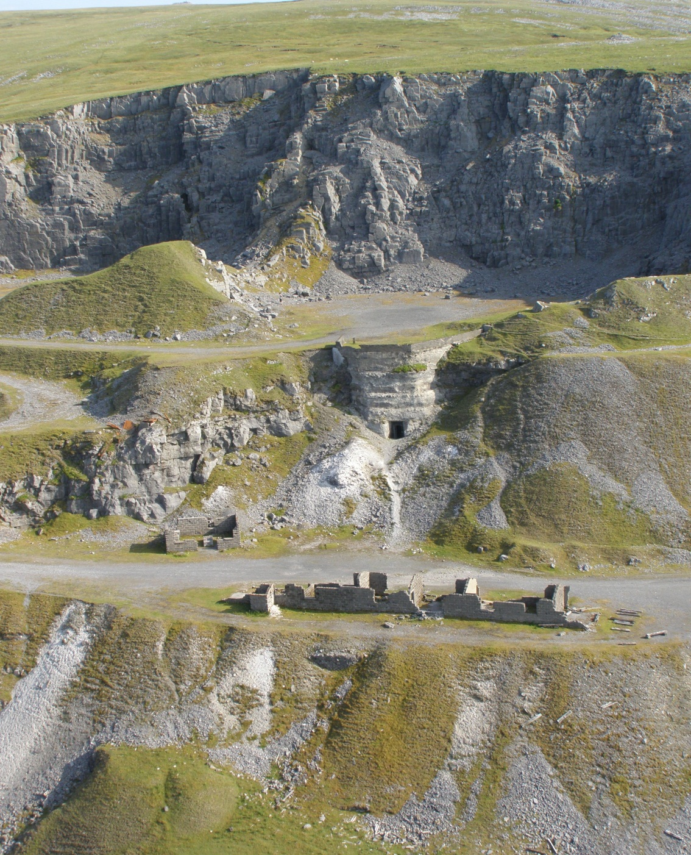
Use these words in your account:
Kiln
Quarry face
Lime
Limestone
Farms
Fields
Crops
Burn

