Slide 1







Art & Design
Unit 1

Slide 2
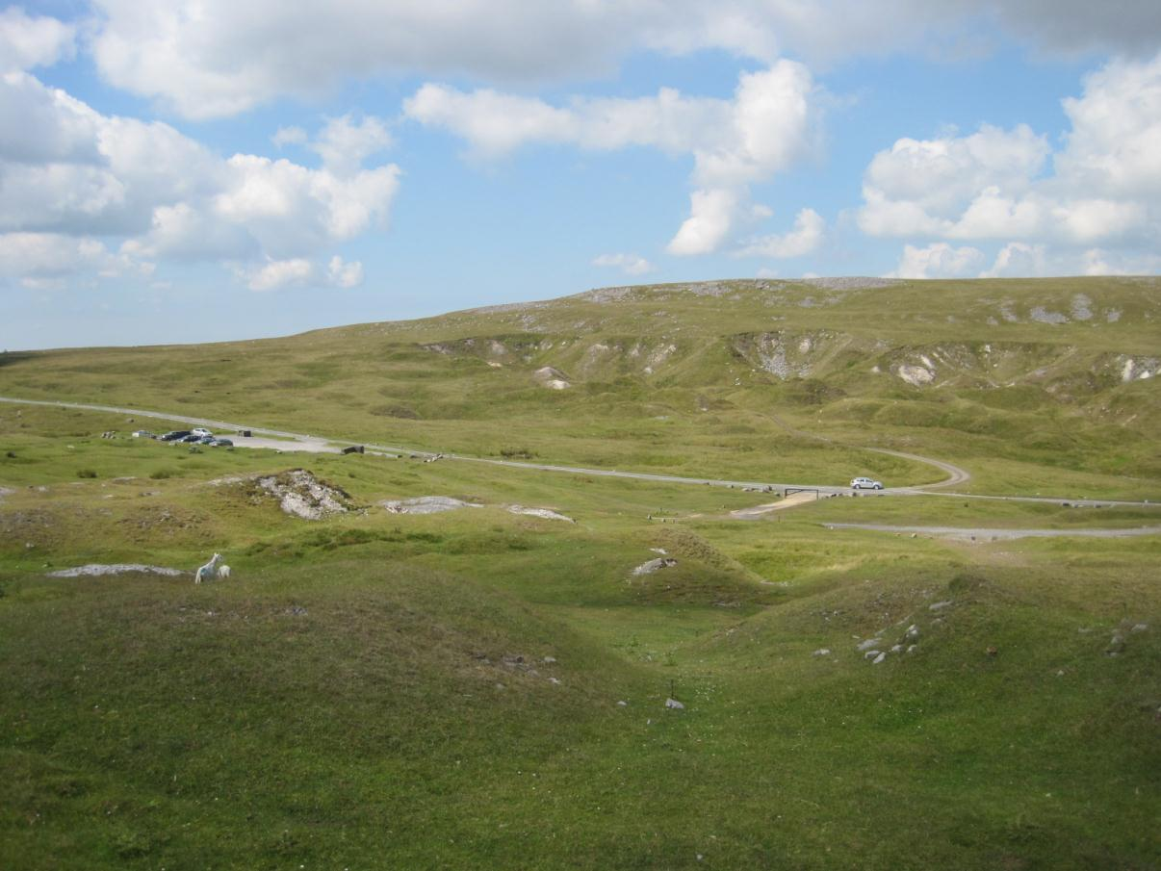
The landscape of the Black Mountain

Slide 3
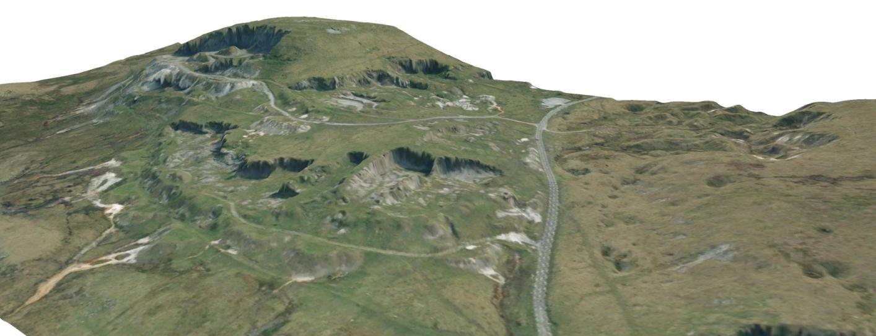
Why does it look like this?

Slide 4
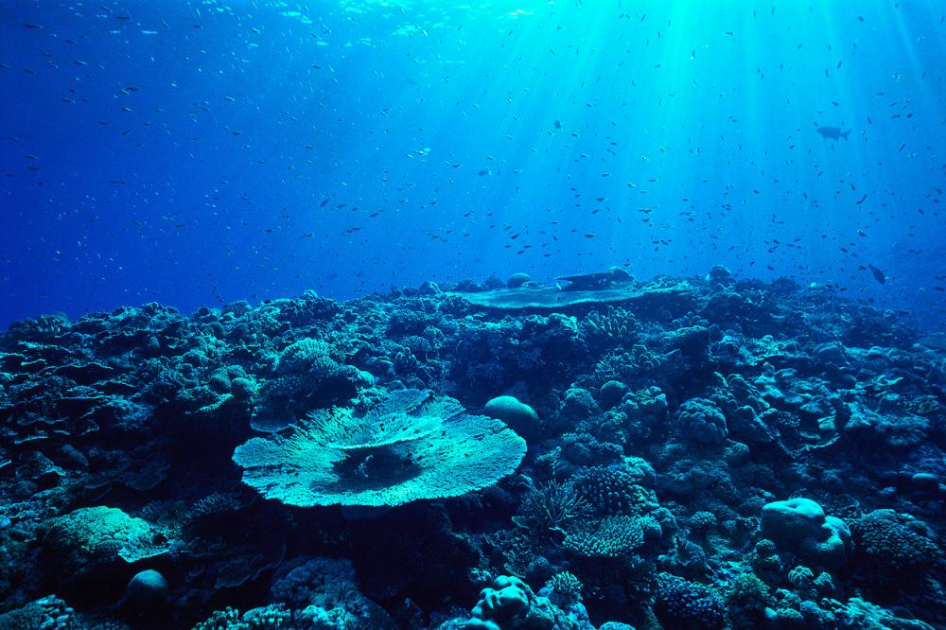
340 million years ago that mountain looked similar to this!

Slide 5
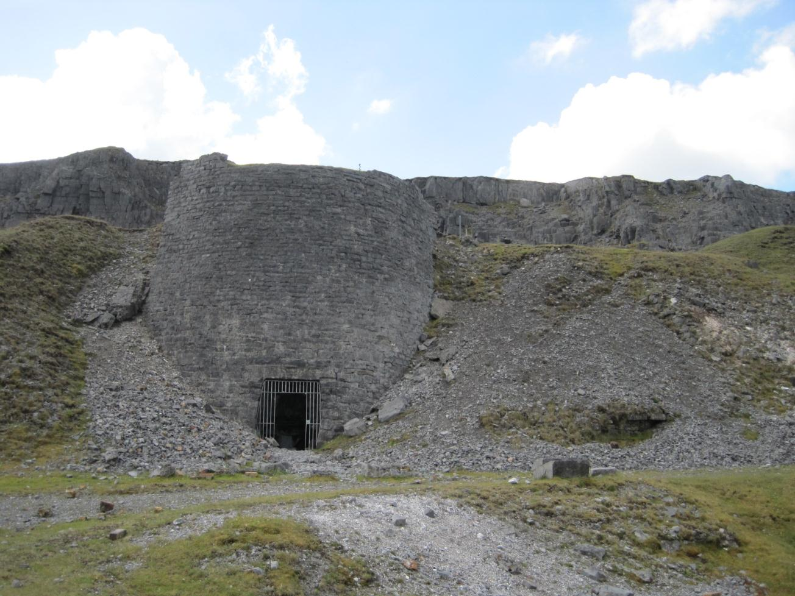
Who built this?
What was it used for?
Why was it abandoned?
When was it built?

Slide 6
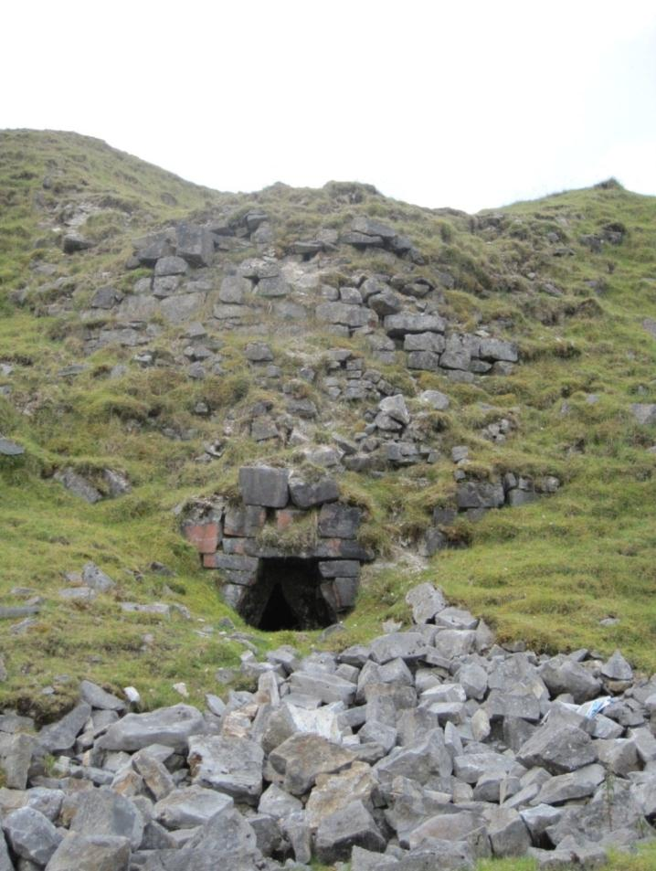
Is this the same as the last picture?

Slide 7
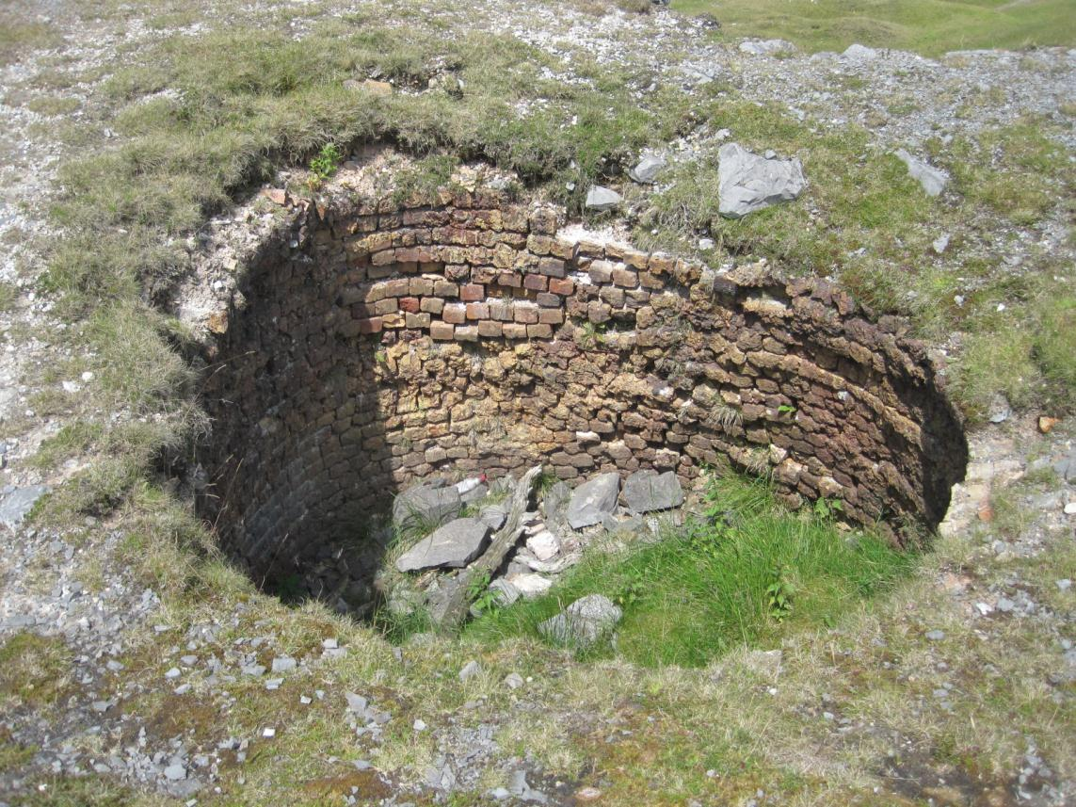
This is a view from the top. Does it change your opinions of what it may be?

Slide 8
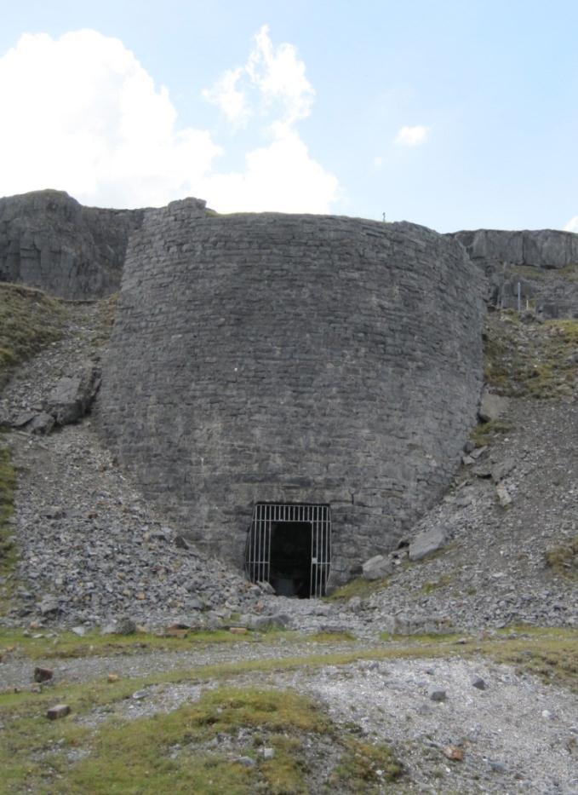
A kiln is a furnace or oven for burning, baking, or drying.
The kilns on the Black Mountain were used to burn lime.

Slide 9
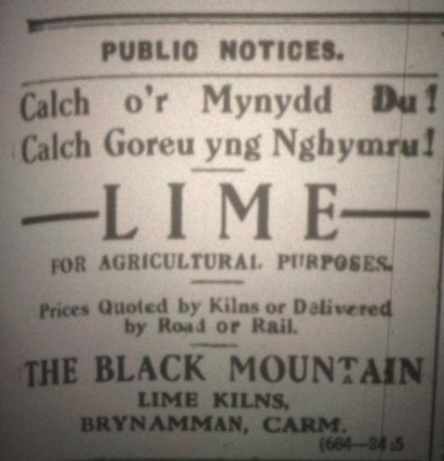
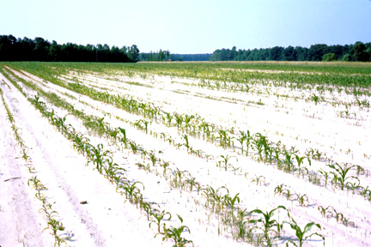
Lime
Lime burning took place on the mountain for over 200 years. It was used in agriculture to neutralise the acidic soil so that crops would grow better.

Slide 10
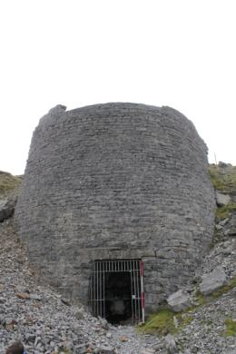
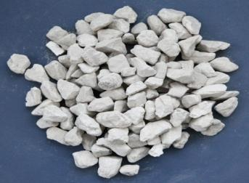
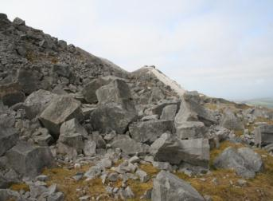

Limestone to quicklime and slaked lime
Limestone is quarried from the mountain.
It is then added to a kiln and burnt at a very high temperature.
Water is added to quicklime to create slaked lime.
LIMESTONE (Calcium carbonate)
CaCO3
QUICKLIME (Calcium oxide)
CaO
CO2 (Carbon dioxide) is lost
SLAKED LIME (Calcium hydroxide)
Ca(OH)2
+ HEAT
+ WATER

Slide 11
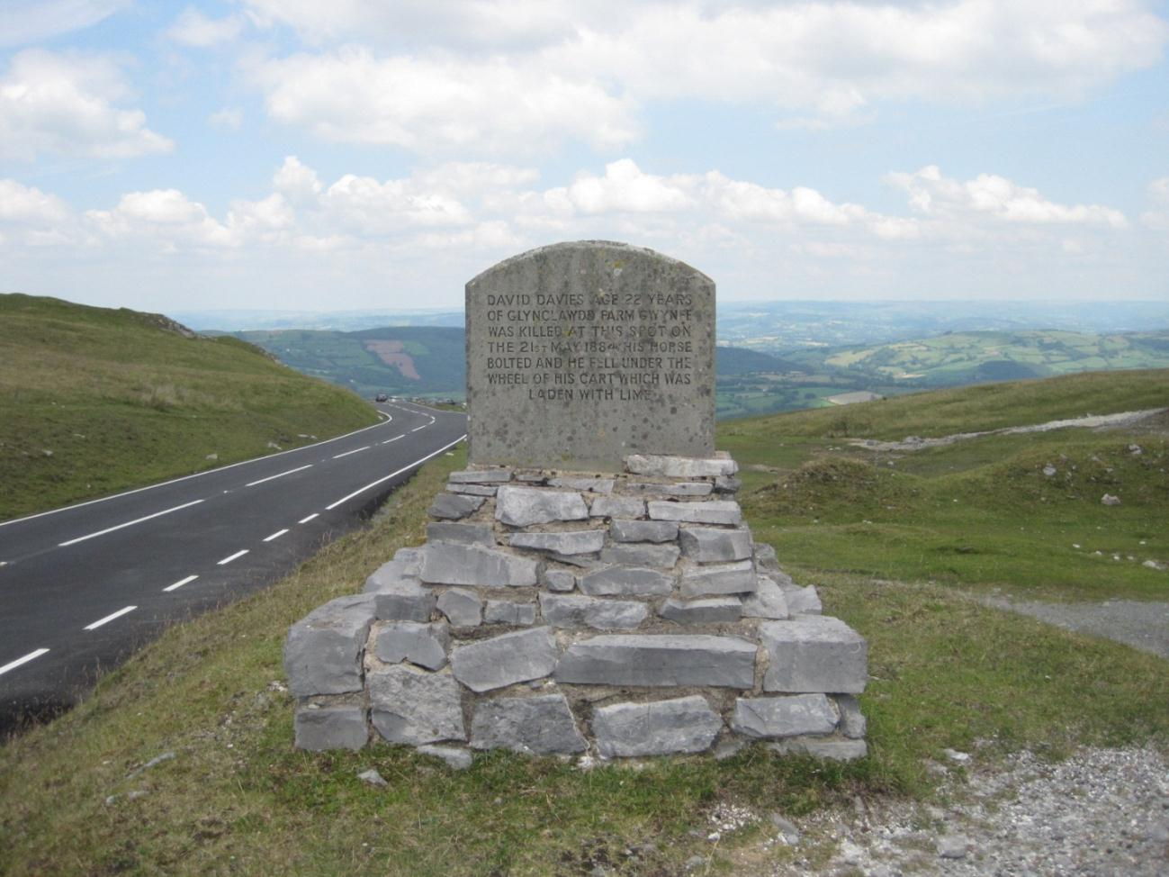

Slide 12
